Slide 1

Software Engineering
CI SYSTEMS
Blerta Jashari

Slide 2
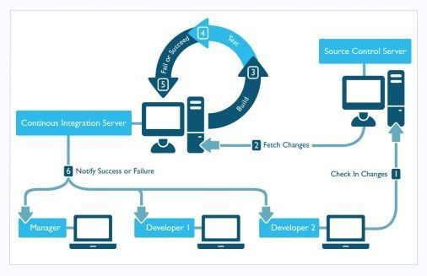
Ci systems
AppVeyor
CodeShip
Travis CI
Circle CI
Drone
Jenkins

Slide 3

AppVeyor
privately-held Canadian corporation founded in 2011
provide continuous integration tools for Windows developers
is offered for free to open-source projects
offer subscriptions for private projects and AppVeyor Enterprise installations on customer premises
is trusted by such companies as Microsoft, Google, Facebook, Mozilla, Slack, GitHub and many others.

Slide 4

CodeShip
grow your projects over time to use more sophisticated workflows and setups.
lets you get your builds setup and working in just a few minutes with a simple UI and a turnkey environment.
you can grow your projects over time to use more sophisticated workflows and setups.

Slide 5

Travis CI
Test and Deploy with Confidence
Testing your open source projects will always be free
Features to help you get the job done
Quick setup
Live build views
Pull request support
Pre-installed database services
Mac, Linux, and iOS support

Slide 6
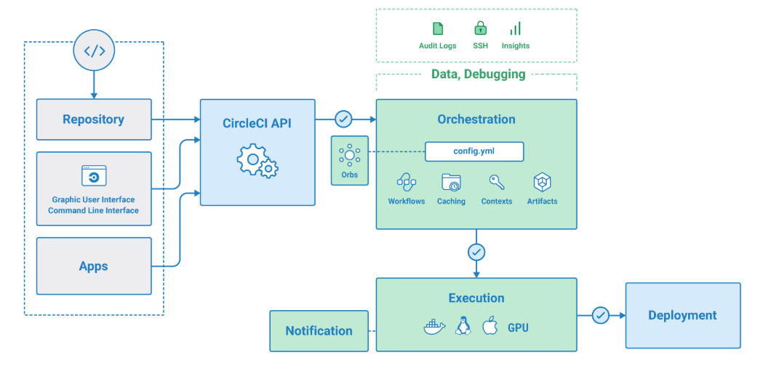
Circle CI
mission is to empower technology-driven organizations to do their best work.
make engineering teams more productive through intelligent automation.
provides enterprise-class support and services, with the flexibility of a startup.
work where you work: Linux, macOS, Android, and Windows - SaaS or behind your firewall.
set up parallelism in your .circleci/config.yml file to run jobs faster
you can SSH into any job to debug your build issues
configure caching with two simple keys to reuse data from previous jobs in your workflow

Slide 7
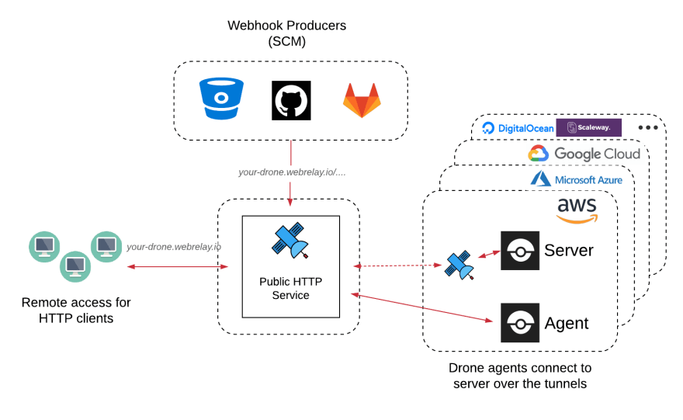
Drone
modern Continuous Integration and Continuous Delivery platform that empowers busy teams to automate their build, test and release workflows.
Easy install & maintenance
isolated builds
Works with any language, database or service that runs inside a Docker container.
will never dictate your build environment.

Slide 8
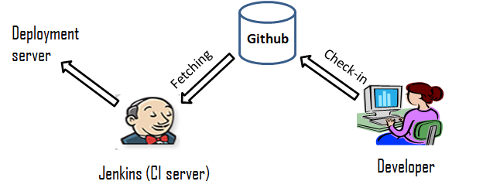
Jenkins
self-contained, open source automation server which can be used to automate all sorts of tasks related to building, testing, and delivering or deploying software.
The leading open source automation server
provides hundreds of plugins to support building, deploying and automating any project.
a highly extensible product whose functionality can be extended through the installation of plugins.

Slide 9
For my project I would like to use Jenkins, this because the pipeline integrates individual jobs for a bigger purpose, keeps people in Sync - especially in slack, project management has more accurate data support.
CI I would choose for my project!

Slide 10
Thank you

